Slide 1
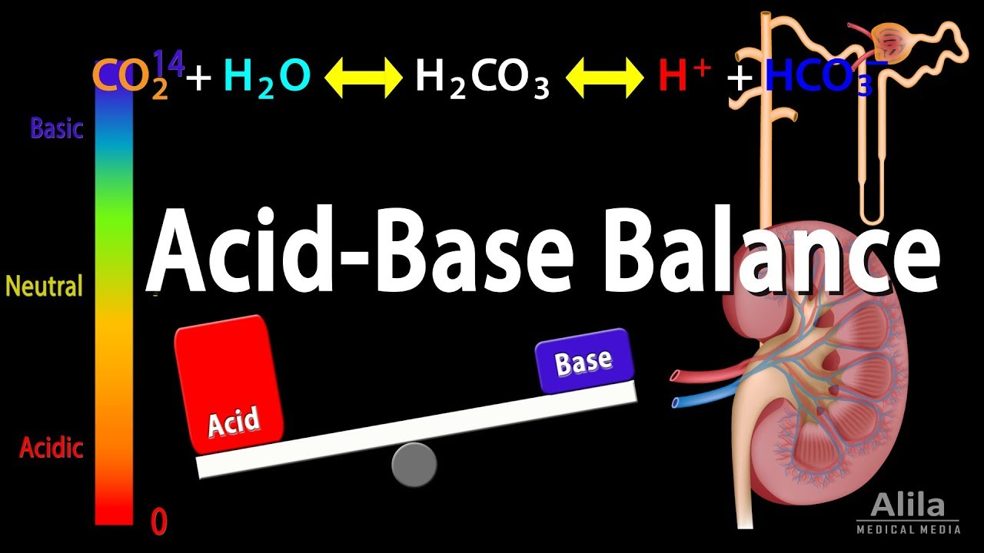

Slide 2
Introduction
Nearly all biochemical reactions in the body are dependent on maintenance of a physiological hydrogen ion concentration.
The concentrations of hydrogen and bicarbonate ions in plasma must be precisely regulated to optimize enzyme activity, oxygen transport, and rates of chemical reactions within cells.
The body is able to maintain this intricate acid-base balance by utilizing buffers, pulmonary excretion of carbon dioxide, and renal elimination of acid.
This regulation—often referred to as acid–base balance—is of prime importance to anesthetists.
Changes in ventilation and perfusion and the infusion of electrolyte-containing solutions are common during anesthesia and can rapidly alter acid–base balance.

Slide 3
Definitions
Acids and Bases
Bronsted and Lowry defined an acid as a molecule that can act as a proton (H+) donor.
A base as a molecule that can act as a proton acceptor.
A strong acid is a substance that readily and almost irreversibly gives up an H + and increases [H + ], whereas a strong base avidly binds H + and decreases [H + ].
In contrast, weak acids reversibly donate H + , whereas weak bases reversibly bind H +.
Biological compounds are either weak acids or weak bases.

Slide 4
Cont….
The free (H+) ion concentration and (HCO3-) in the blood must be precisely maintained with in very narrow limits to maintain life.
This regulation often referred to as acid–base balance.
At 37° C, the normal hydrogen ion concentration in arterial blood and extracellular fluid is 35 to 45 nmol/L, which is equivalent to an arterial pH of 7.45 to 7.35, respectively.
The normal plasma bicarbonate ion concentration is 24 ± 2 mEq/L.
The normal plasma CO2 (PaCO2) level is 35-45 mmHg.
Almost all enzyme systems in the body are influenced by H+ concentration.

Slide 5
Production of Hydrogen Ions
The processes of metabolism generate hydrogen ions.
Oxidation of amino acids and the anaerobic metabolism of glucose to lactic and pyruvic acid.
Far more acid is produced as a result of carbon dioxide (CO2) release from oxidative (aerobic) metabolism.
Acids or bases may also be ingested

Slide 6
Normal hydrogen ion concentration and pH of body fluids
The blood H+ concentration is normally maintained within tight limits around a normal value of about (40nEq/L).
Normal variations are only about 3 to 5 nEq/L, but under extreme conditions, the H+ concentration can vary from as low as 10 nEq/L to as high as 160 nEq/L without causing death.
The intracellular hydrogen ion concentration is approximately 160 nmol/L, which is equivalent to a pH of 6.8.

Slide 7
pH
A much simpler way to describe [H+].
Ranges from 0 to 14
Is a convenient descriptor for power of hydrogen.
PH = -log [H+].
Inversely related to the H+ concentration
The normal pH of arterial blood is 7.35-7.45

Slide 8
Cont….
A person is considered to have acidosis when the pH falls below 7.4.
Caused by accumulation of acid or loss of base.
To have alkalosis when the pH rises above 7.4.
Caused by accumulation of base or loss of acid.
The lower limit of pH at which a person can live more than a few hours is about 6.8, and the upper limit is about 8.0.

Slide 9
Henderson-Hasselbalch Equation
Defines the relationship between pH and concentrations of conjugate acid and base.
A change in concentration of any component in an equilibrium reaction necessitates a concomitant change in every component.
Henderson and hasselbalch equation is a convenient way of viewing the relationship between
PH of a solution and
Relative amounts of conjugate base and acid present

Slide 10
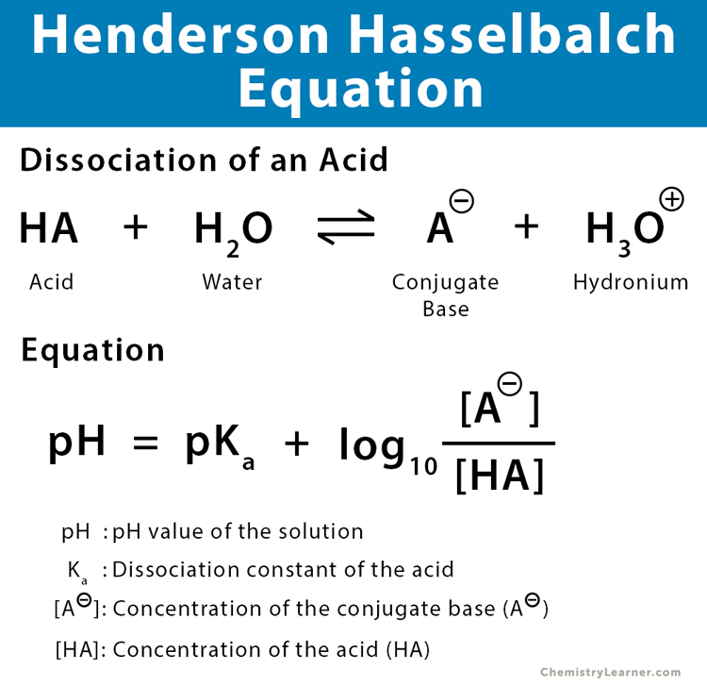
Cont….

Slide 11
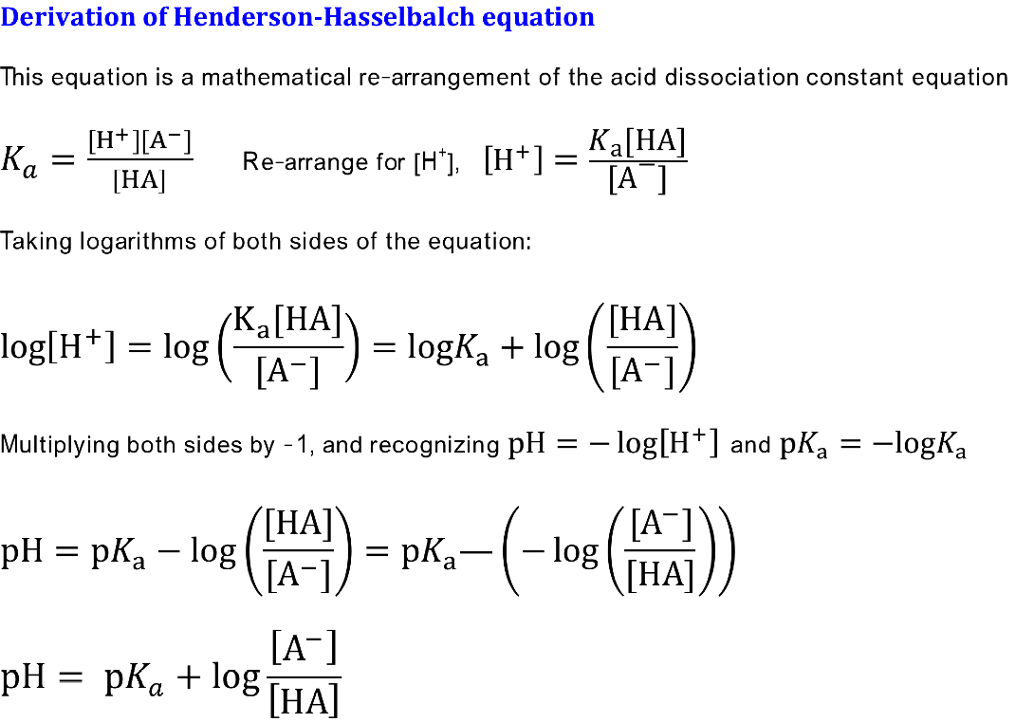
Cont..

Slide 12
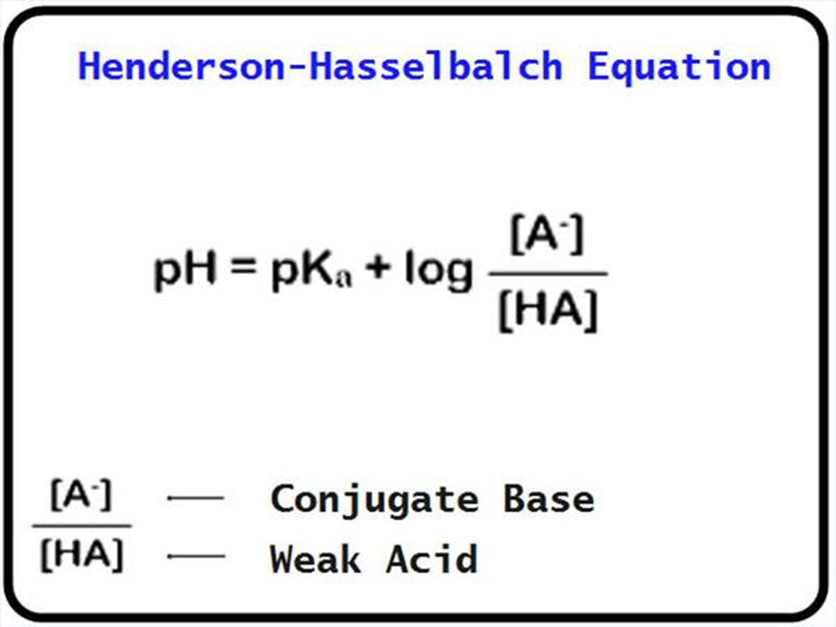
Cont….

Slide 13
Common acid-base disorders and their compensation
Any disorder that tends to reduce pH to a less than normal value is an acidosis.
Whereas one tending to increase pH is termed an alkalosis .
If the disorder primarily affects [HCO 3 − ], it is termed metabolic .
If the disorder primarily affects PaCo2 , it is termed respiratory.
Because arterial blood pH is normally 7.35–7.45 in adults, the term acidemia signifies a pH <7.35, whereas alkalemia signifies a pH >7.45.

Slide 14
Defining acid–base disorders
Disorder | Primary change | Compensatory Response
Respiratory Acidosis Alkalosis | Increase PaCo2 Decrease PaCo2 | Increase HCO3- Decrease HCO3-
Metabolic Acidosis Alkalosis | Decrease HCO3- Increase HCO3- | Decrease PaCo2 Increase PaCo2

Slide 15
Regulation of the hydrogen ion concentration
Physiologic changes to acid-base disturbances are corrected by three systems—
Buffers
Ventilation and
Renal response.
The buffer systems provide an immediate chemical response.
The ventilatory response occurs in minutes whenever possible, and,
The renal response can slowly provide nearly complete restoration of the pH, but it can take days.

Slide 16
Buffer Systems
A buffer is defined as a substance within a solution that can prevent extreme changes in pH.
A buffer is a solution that contains a weak acid and its conjugate base or a weak base and its conjugate acid.
The chemical acid-base buffer systems of the body fluids, which immediately combine with acid or base to prevent excessive changes in H+ concentration.
Buffer systems do not eliminate H+ from or add them to the body but only keep them tied up until balance can be reestablished.

Slide 17
Cont…
The base molecules of the buffer system bind excess hydrogen ions, and the weak acid protonates excess base molecules.
The dissociation ionization constant (Ka) is a quantitative measure of the extent to which a compound dissociates into its constituent ions in a solution.
A higher Ka value indicates a stronger acid that dissociates more completely.
The negative logarithm of the acid dissociation constant (pKa) measures how completely an acid dissociates into its ions in solution.
The lower the value of pKa, the stronger the acid and the greater its ability to donate its protons.

Slide 18
Buffering of H+ ions in the body fluids (General rule)
Buffer + H HBuffer
Free H+ combines with the buffer to form a weak acid (H buffer) that can either remain as an unassociated molecule or dissociate back to buffer and H+
When the H+ concentration increases, the reaction is forced to the right, and more H+ binds to the buffer, as long as buffer is available.
Conversely, when the H+ concentration decreases, the reaction shifts toward the left, and H+ is released from the buffer

Slide 19
Cont…
The most important buffer systems in blood are the
(1) Bicarbonate buffer system (H2CO33/HCO3-3−)
(2) Hemoglobin buffer system (HbH/Hb-)
(3) Other protein buffer systems (PrH/Pr-)
(4) Phosphate buffer system (H2PO4-/HPO4 2-), and
(5) Ammonia buffer system (NH3-/NH4+).

Slide 20
Cont…
Bicarbonate is the most important buffer in the extracellular fluid compartment.
Hemoglobin, though restricted inside red blood cells, also functions as an important buffer in blood.
Other proteins probably play a major role in buffering the intracellular fluid compartment.
Phosphate and ammonium ions are important urinary buffers.

Slide 21

The Bicarbonate Buffer
Quantitatively the most important in the extracellular fluid.
Consist of a water solution that contains
H2CO3 and HCO3-
CO2 + H2O H2CO3 H+ + HCO3 -
Bicarbonate Buffer System Is the Most Important Extracellular Buffer

Slide 22
Cont….
The concentration of bicarbonate ion is regulated by the kidney and the concentration of carbon dioxide (carbonic acid) is regulated by the respiratory system.
Carbon dioxide, generated through aerobic metabolism, slowly combines with water to form carbonic acid, which spontaneously and rapidly deprotonates to form bicarbonate.
In this system, the base molecule is bicarbonate, and its weak conjugate acid is carbonic acid.

Slide 23
Cont…
When a strong acid such as HCl is added to the bicarbonate buffer solution, the increased H+ released from the acid is buffered by HCO3–.
HCl H+ + Cl-
H+ + HCO3– H2CO3 CO2 + H2O
As a result, more H2CO3 is formed, causing increased CO2 and H2O production.
From these reactions H+ from the strong acid HCl reacts with HCO3 – to form the very weak acid H2CO3, which in turn forms CO2 and H2O.

Slide 24
The phosphate Buffer System
This system consists of a weak acid dihydrogen phosphate (H2PO4) in the form of sodium dihydrogen phosphate and the base hydrogen phosphate (HPO4).
Hcl + Na2 HPO4 → Na H2PO4 + NaCl
(Strong acid) (Weak acid)
NaOH + NaH2PO4 → Na2 HPO4 + H2O
(Strong base) (Weak base)

Slide 25
Protein buffer
Accounts for the majority of intracellular buffering
Many proteins, and notably albumin, contain weak acidic and basic groups within their structure.
Plasma and other proteins form important buffering systems.
Intracellular proteins limit pH changes within cells

Slide 26
Hemoglobin Buffer System
The hemoglobin protein is the second most important buffering system because of multiple histidine residues.
Histidine is an effective buffer from pH 5.7 to 7.7 because it contains multiple protonatable sites on the imidazole side chains.
Carbon dioxide freely diffuses into erythrocytes, where it combines with water to form carbonic acid, which rapidly deprotonates.
The protons generated are bound up by hemoglobin.
The bicarbonate anions are exchanged back into plasma.

Slide 27
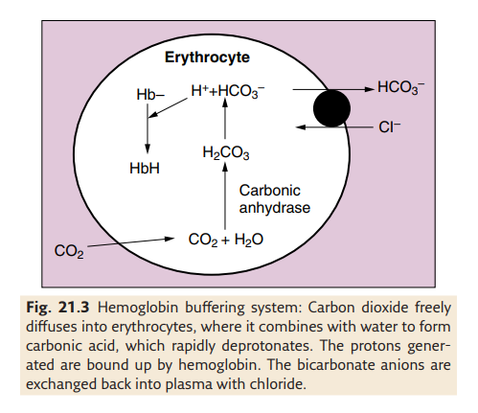
Cont.…

Slide 28
Respiratory acid base compensation
Changes in alveolar ventilation responsible for the respiratory compensation of Paco2 are mediated by chemoreceptor within the brainstem.
These receptors respond to changes in cerebrospinal fluid pH.
Carbon dioxide diffuses across the blood-brain barrier to elevate cerebrospinal fluid (CSF) hydrogen ion concentration, which activates the chemoreceptors and increases alveolar ventilation
Minute ventilation increases 1–4 L/min for every (acute) 1 mm Hg increase in Paco2 .
Adjustments by the respiratory take minutes to hours to accomplish

Slide 29
Cont….
Peripheral chemoreceptors are located at the bifurcation of the common carotid arteries and surrounding the aortic arch.
The carotid bodies are the principal peripheral chemoreceptors and are sensitive to changes in PaO2, PaCo2, pH, and arterial perfusion pressure.
Unlike the central chemoreceptors, which are more sensitive to hydrogen ions, the carotid bodies are most sensitive to PaO2..
If the rate of metabolic formation of carbon dioxide becomes increased, its concentration in the ECF is likewise increased.
Conversely, decreased metabolism decreases the carbon dioxide production.

Slide 30
Cont…
On the other hand if the rate of pulmonary ventilation is increased, carbon dioxide is blown off from the lungs & the amount of carbon dioxide in the ECF decreases.
The pulmonary response to metabolic alkalosis is usually less than the response to metabolic acidosis.
The reason is because progressive hypoventilation results in hypoxemia when breathing room air.
Hypoxemia activates oxygen-sensitive chemoreceptors and limits the compensatory decrease in minute ventilation.
Because of this, the PaCO2 usually does not rise above 55 mm Hg in response to metabolic alkalosis for patients not receiving oxygen supplementation.

Slide 31
Renal acid-base compensation
The ability of the kidneys :
To control the amount of HCO3− reabsorbed from filtered tubular fluid,
Form new HCO3− , and
Eliminate H+ in the form of titratable acids and ammonium ions.
Allows them to exert a major influence on pH during both metabolic and respiratory acid–base disturbances

Slide 32
Renal Compensation During Acidosis
The renal response to acidemia is 3-fold:
Increased reabsorption of the filtered HCO 3 −
(2) Increased excretion of titratable acids, and
(3) Increased production of ammonia.
In the tubular fluid, ammonia combines with hydrogen ion to form NH4 which is trapped within the tubule and excreted in the urine.
Although these mechanisms are probably activated immediately, their effects are generally not appreciable for 12–24 hr and may not be maximal for up to 5 days.

Slide 33
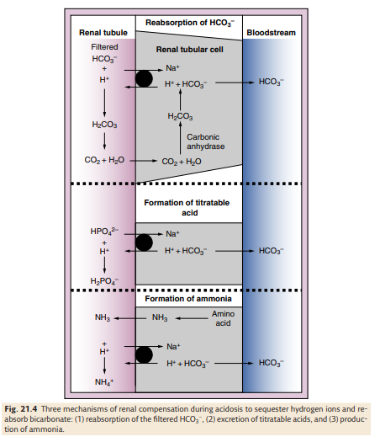

Slide 34
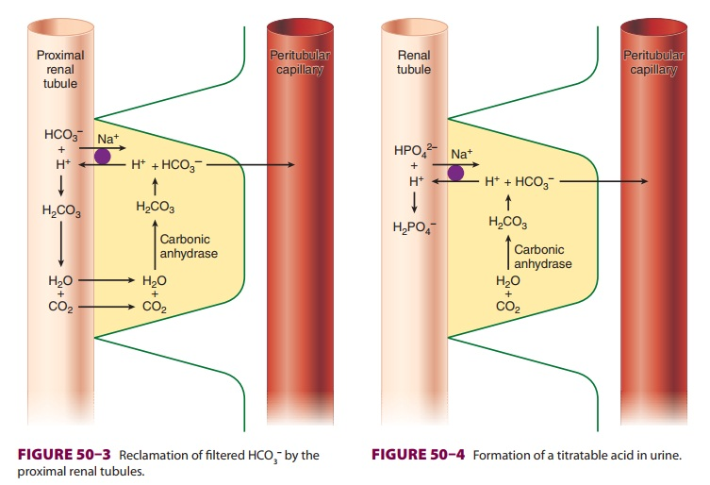
Cont…

Slide 35
Renal Compensation During Alkalosis
The tremendous amount of HCO 3 − normally filtered and subsequently reabsorbed allows the kidneys to rapidly excrete large amounts of bicarbonate.
As a result, the kidneys are highly effective in protecting against metabolic alkalosis.

Slide 36
Acidosis
Severe acidemia is defined as blood pH <7.20 and is associated with the following major effects:
Impairment of cardiac contractility, cardiac output, and the response to catecholamines.
Susceptibility to recurrent arrhythmias and lowering the threshold for ventricular fibrillation
Arteriolar vasodilation resulting in hypotension
Vasoconstriction of the pulmonary vasculature, leading to increased pulmonary vascular resistance

Slide 37
Cont….
Hyperventilation (a compensatory response)
In the brain, this rapid increase in carbon dioxide can lead to confusion, loss of consciousness, and seizures.
Insulin resistance
Inhibition of glycolysis and adenosine triphosphate synthesis
Hyperkalemia as potassium ions are shifted extracellularly

Slide 38
Respiratory acidosis
Respiratory acidosis occurs when alveolar minute ventilation is inadequate relative to carbon dioxide production.
Primary disorder is a ↓PH due to ↑Paco2(>45mmHg), i. e. hypercapinea.
Partial pressure of carbo-ndioxide (Paco2) represents the balance between CO2 production and CO2 elimination
Pa CO2 = CO2production ∕Alveolar ventilation
CO2 is a byproduct of fat and carbohydrate metabolism
Respiratory acidosis may produce more rapid and profound myocardial dysfunction than metabolic acidosis because of the rapid entry of carbon dioxide into the cardiac cell.
Unlike CO2, H+ ions do not readily penetrate the blood–brain barrier

Slide 39
Causes of respiratory acidosis
Alveolar hypoventilation
Central nervous system depression
Drug-induced
Sleep disorders
Obesity hypoventilation
Cerebral ischemia
Cerebral trauma
Neuromuscular disorders
Myopathies
Neuropathies
Chest wall abnormalities
Flail chest
Kyphoscoliosis

Slide 40
Cont….
Pleural abnormalities
Pneumothorax
Pleural effusion
Airway obstruction
Upper airway
Foreign body
Tumor
Laryngospasm
Sleep disorders
Lower airway
Severe asthma
Chronic obstructive pulmonary disease
Tumor

Slide 41
Cont….
Parenchymal lung disease
Pulmonary edema
Cardiogenic
Noncardiogenic
Pulmonary emboli
Pneumonia
Aspiration
Interstitial lung disease
Ventilator malfunction

Slide 42
Cont….
Increased CO 2 production
Large caloric loads
Malignant hyperthermia
Intensive shivering
Prolonged seizure activity
Thyroid storm
Extensive thermal injury (burns)

Slide 43
Causes of respiratory acidosis
Increased CO2 production
Malignant hyperthermia
Hyperthyroidism
Sepsis
Overfeeding
Decreased CO2 elimination
Intrinsic pulmonary disease (pneumonia, ARDS, fibrosis, edema)
Upper airway obstruction (laryngospasm, foreign body, OSA)
Lower airway obstruction (asthma, COPD)
Chest wall restriction (obesity, scoliosis, burns)
CNS depression (anesthetics, opioids, CNS lesions)
Decreased skeletal muscle strength (residual effects of
neuromuscular blocking drugs, myopathy, neuropathy)
Increased CO2 rebreathing or absorption
Exhausted soda lime
Incompetent one-way valve in breathing circuit
Laparoscopic surgery

Slide 44
Acute Respiratory Acidosis
The compensatory response to acute (6–12 h) elevations in Paco2 is limited.
Buffering is primarily provided by hemoglobin and the exchange of extracellular H+ for Na+ and K+ from the intracellular fluid compartment.
The renal response to retain more bicarbonate is acutely very limited.
As a result, plasma [HCO 3 − ] increases only about 1 mEq/L for each 10 mm Hg increase in Pa CO 2 above 40 mm Hg.

Slide 45
Chronic Respiratory Acidosis
“Full” renal compensation characterizes chronic respiratory acidosis.
Renal compensation is appreciable only after 12–24 hr and may not peak until 3–5 days.
During chronic respiratory acidosis, plasma [HCO3−] increases approximately 4 mEq/L for each 10 mm Hg increase in Paco2 above 40 mm Hg.

Slide 46
Treatment of respiratory acidosis
Respiratory acidosis is treated by reversing the imbalance between CO2 production and alveolar ventilation.
In most instances, this is accomplished by increasing alveolar ventilation.
Potential temporizing measures aimed at improving alveolar ventilation (in addition to controlled mechanical ventilation) include bronchodilation, reversal of narcosis, or improving lung compliance.
Measures aimed at reducing CO2 production are useful only in specific instances e.g.
Dantrolene for malignant hyperthermia
Antithyroid medication for thyroid storm, and
Reduced caloric intake in patients receiving enteral or parenteral nutrition).
Intravenous sodium bicarbonate (NaHCO3) is rarely necessary, unless pH is <7.10 and HCO3 is <15 mEq/L.

Slide 47
Metabolic acidosis
Metabolic acidosis is defined as a primary decrease in [HCO 3 − ].
Primary disorder is a ↓PH due to ↓[HCO3−].
Pathological processes can initiate metabolic acidosis by one of three mechanisms:
1) Consumption of HCO3− by a strong nonvolatile acid
2) Renal or gastrointestinal wasting of bicarbonate, or
3) Rapid dilution of the extracellular fluid compartment with a bicarbonate-free fluid

Slide 48
Causes of Metabolic acidosis
Increased anion gap; ↑ fixed [H+]
Increased production of endogenous nonvolatile acids
Ingestion of toxin
Rhabdomyolysis
Normal anion gap; loss or ↓ reabsorption of HCO3−
Increased gastrointestinal losses of HCO3−
Increased renal losses of HCO3−
Dilutional

Slide 49
Treatment of metabolic acidosis
Intravenous administration of sodium bicarbonate is often given for a non anion gap metabolic acidosis because the problem is bicarbonate loss.
If arterial blood pH remains below 7.20, alkalin therapy, usually in the form of NaHCO3 (usually a 7.5% solution), may be necessary.
Management of an anion gap metabolic acidosis is guided by diagnosis and treatment of the underlying cause in order to remove the nonvolatile acids from the circulation.
Specific therapy for diabetic ketoacidosis includes replacement of the existing fluid deficit(as a result of a hyperglycemic osmotic diuresis) first, as well as insulin, potassium.
Tissue hypoxia leading to lactic acidosis should be corrected if possible with oxygen, fluid resuscitation, and circulatory support.

Slide 50
Anesthetic consideration of patients with acidosis
Acidemia can potentiate the depressant effects of most sedatives and anesthetic agents on the CNS and circulatory systems.
Increased sedation and depression of airway reflexes may predispose to pulmonary aspiration.
So it is important to recognize and treat acidosis immediately before anesthesia .
Avoid sedatives , cardiovascular and respiratory depressant anesthetics drug in patients with acidosis.

Slide 51
Alkalosis
Abnormal condition increasing arterial PH.
Severe alkalemia is defined as blood pH >7.60 and is associated with the following major physiological effects:
Decreased cerebral and coronary blood flow as a result of arteriolar vasoconstriction.
Refractory ventricular arrhythmias
Coronary artery spasm/vasoconstriction
In the lungs, respiratory alkalosis increases bronchial smooth muscle tone (bronchoconstriction) but
Vasodilatation of the pulmonary vasculature, leading to decreased pulmonary vascular resistance

Slide 52
Cont….
Hypoventilation (which can frustrate efforts to wean patients from mechanical ventilation)
Cerebral vasoconstriction
Alkalosis increases the affinity of hemoglobin for oxygen and shifts the oxygen dissociation curve to the left making it more difficult for hemoglobin to give up oxygen to tissues.
Movement of H+ out of cells in exchange for the movement of extracellular K+ into cells can produce hypokalemia.

Slide 53
Respiratory alkalosis
Respiratory alkalosis is defined as a primary decrease in Paco2.
The mechanism is usually an inappropriate increase in alveolar ventilation relative to CO2 production.
The decreased PaCO2 and increased pH trigger the peripheral and central chemoreceptors to decrease the stimulus to breathe.

Slide 54
Causes of respiratory alkalosis.
Central stimulation
Pain
Anxiety
Ischemia
Stroke
Fever
Peripheral stimulation
Hypoxemia
High altitude

Slide 55
Treatment of Respiratory Alkalosis
Respiratory alkalosis is compensated by decreased reabsorption of bicarbonate ions from the renal tubules and increased urinary excretion of bicarbonate.
Treatment of respiratory alkalosis is directed at correcting the underlying disorder.
In rare cases, severe acute respiratory alkalosis (pH > 7.6) may require sedation.
During general anesthesia, acute respiratory alkalosis is easily remedied by decreasing total minute ventilation.

Slide 56
Metabolic alkalosis
Metabolic alkalosis is present when the pH is higher than 7.45 due to gain of bicarbonate ions or loss of hydrogen ions.
Most cases of metabolic alkalosis can be divided into:
Chloride sensitive (NaCl deficiency and extracellular fluid depletion and urinary Chloride concentration <25mg/dl)
Chloride-resistant (associated with enhanced mineralocorticoid activity and urinary Chloride concentration >25mg/dl)

Slide 57
Chloride-Sensitive Metabolic Alkalosis
Depletion of extracellular fluid causes the renal tubules to avidly reabsorb Na+.
Because not enough Cl– is available to accompany all the Na+ ions reabsorbed, increased H+ secretion must take place to maintain electroneutrality.
In effect, HCO3– ions that might otherwise have been excreted are reabsorbed, resulting in metabolic alkalosis.

Slide 58
Causes of metabolic alkalosis
Chloride-sensitive
Gastrointestinal
Vomiting
Gastric drainage
Chloride diarrhea
Renal
Diuretics
Low chloride intake

Slide 59
Chloride-Resistant Metabolic Alkalosis
Increased mineralocorticoid activity commonly results in metabolic alkalosis, even when it is not associated with extracellular volume depletion.
Inappropriate increases in mineralocorticoid activity cause sodium retention and expansion of extracellular fluid volume.
Increased H + and K + secretion takes place to balance enhanced mineralocorticoid mediated sodium reabsorption, resulting in metabolic alkalosis and hypokalemia.
Urinary chloride concentrations are typically greater than 20 mEq/L in such cases.

Slide 60
Causes of metabolic alkalosis
Chloride-resistant
Increased mineralocorticoid activity
Primary hyperaldosteronism
Edematous disorders (secondary hyperaldosteronism)
Cushing’s syndrome

Slide 61
Treatment of Metabolic Alkalosis
Treat the underlying cause.
Decreasing minute ventilation to normalize Paco2 .
Administration of intravenous saline (NaCl) and potassium (KCl).
H2-blocker therapy is useful when excessive loss of gastric fluid is a factor.
Alkalosis associated with primary increases in mineralocorticoid activity readily responds to aldosterone antagonists (spironolactone).

Slide 62
Anesthetic considerations in patients with alkalemia
Prolong the duration of opioid-induced respiratory depression
Cerebral ischemia can occur from marked reduction in cerebral blood flow during respiratory alkalosis, particularly during hypotension.
The combination of alkalemia and hypokalemia can precipitate severe atrial and ventricular arrhythmias.
Potentiation of nondepolarizing neuromuscular blockade is reported with alkalemia

Slide 63
Diagnosis of acid-base disorders
Interpretation of acid–base status from analysis of blood gases requires a systematic approach.
A recommended approach follows
Examine arterial pH: Is acidemia or alkalemia present?
pH less than 7.35 acid pH greater than 7.45 base
2. Metabolic or Respiratory
Bicarbonate= Base CO2= Acid
3. Compensation? Is there any compensation to bring back the pH to normal value?

Slide 64
E.g 1. Mister x was admitted in ICU. Analysis of the arterial blood gave the following values, PH 7.15, PC02 44, HCO3- 19. What is the undelying acid base disorder?
Answer Metabolic Acidosis
E.G 2. Analysis of the arterial blood gave the following values, PH 7.6, PC02 21, HCO3- 22. What is the underlying acid base disorder?
Answer Respiratory alkalosis

Slide 65
E.g. 3 Analysis of the arterial blood gave the following values, PH 7.5, PC02 37, HCO3- 29. What is the underlying acid base disorder?
Answer Metabolic Alkalosis
E.g. 4 Analysis of the arterial blood gave the following values, PH 7.31, PC02 49, HCO3- 24. What is the underlying acid base disorder?
Answer Respiratory Acidosis

Slide 66
E.G 5 Analysis of the arterial blood gave the following values, PH 7.47, PC02 26, HCO3- 19. What is the underlying acid base disorder?
Answer Partially compensated Respiratory Alkalosis
E.G 6. Analysis of the arterial blood gave the following values, PH 7.34, PC02 30, HCO3- 20. What is the underlying acid base disorder?
Answer Partially compensated Metabolic Acidosis

Slide 67
Thank you!
???

